Slide 1
Fuel Cell Conference 2019 Bertil Wahlund Energiforsk

Slide 3
Energiforsk
Energibolagens verktyg för forskning och innovation
Driver gemensam efterfrågestyrd forskning och utveckling inom energiområdet på affärsmässiga grunder
Icke vinstutdelande aktiebolag
Oberoende
Ägare:

Slide 4
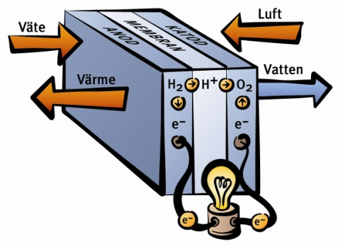
Technology watch of Fuel Cells
Focus: fuel cells, mainly transport and stationary
Aim: follow the development, provide unbiased information, provide a platform
How: tech watch projects, technology or pre-studies, dissemination
Financing: Energimyndigheten
Theme within SEC
Energiforsk project leader
2017 – mid 2019

Slide 5
Technology watch of Fuel Cells
PROJECTS 2017-2019
Praktiska tillämpningar av bränsleceller i tunga fordon, SP Viktoria
Fuel cell vehicles and systems for transports of construction materials in cities, TFK
Hydrogen fuel cell trucks 2030 – next step, Rise Viktoria
Can fuel cells become a mass produced option globally for heavy duty trucks 2030+?, Chalmers
Projektering för utveckling av el- och bränslecellsdrivna dragfordon, BW konstruktion AB
Kostnadsfunktion för bränslecellssystemet, Rise Viktoria
Att lagra vätgas, Rise Viktoria & Sweco
Bränslecellsdrivna lastcykelfordon med extra funktionalitet, mini-demo, Rise SP
Bränsleceller i fordon och hanteringsmaskiner i intermodala transportsystem, TFK

Slide 6
Technology watch of Fuel Cells
PROJECTS
Teknikbevakning bränslecellsområdet med fokus på stationära tillämpningar, Sweco
Teknikbevakning avseende SOFC och FC modellering, LTH
Teknikbevakning SOFC (and SOEC), Chalmers
Syntesrapport 2016 -2017 & 2019, Rise Viktoria/Sweco
Results presented today
Reports at Energiforsk and SEC webpages http://www.energiforsk.se/program/teknikbevakning-bransleceller/

Slide 7
What’s next?
New programme
Hydrogen and Fuel Cells

Slide 8
New programme Hydrogen and Fuel Cells
Focus: Hydrogen and fuel cells
Who: Stakeholders over the entire value chain
producers, distributors, users, municipalities, suppliers of fuel cells and components and materials
How: Conduct technology watch and R&D
Aim: to follow the development, provide unbiased and updated information, provide a platform
Industry financed, level up with state funds when possible
project packages?
Steering committee with participating companies
Cooperation with SEC
Preliminary project period: 2019-09-01 – 2022-09-01

Slide 9
New programme Hydrogen and Fuel Cells
Example of topics, based on interest
Transport
Heavy applications (busses & trucks), working machines, rail bound, marine
Comparisons and analyses, market and technology status
Stationary
Role for fuel cells and electrolysers in energy systems, integration of hydrogen and fuel cells, production and utilisation
Back up power
Production of hydrogen (and electro fuels)
Comparisons of different electro fuels (H2, methane, ammonia …), power-2-X, local reforming
Energy storage for hydrogen
Chemical, cryo …

Slide 10
New programme Hydrogen and Fuel Cells
Interested?
Contact
Bertil Wahlund
Energiforsk
070-677 25 22
bertil.wahlund@energiforsk.se

Slide 11
Thank you

