Slide 1
European Hydrogen Week

Slide 2
Hydrogen Europe
European association representing the interest of the hydrogen industry and its stakeholders.
More than 400+ members, including 25+ EU regions and 30+ national associations
Encompass the entire value chain of the European hydrogen and fuel cell ecosystem.

Slide 3
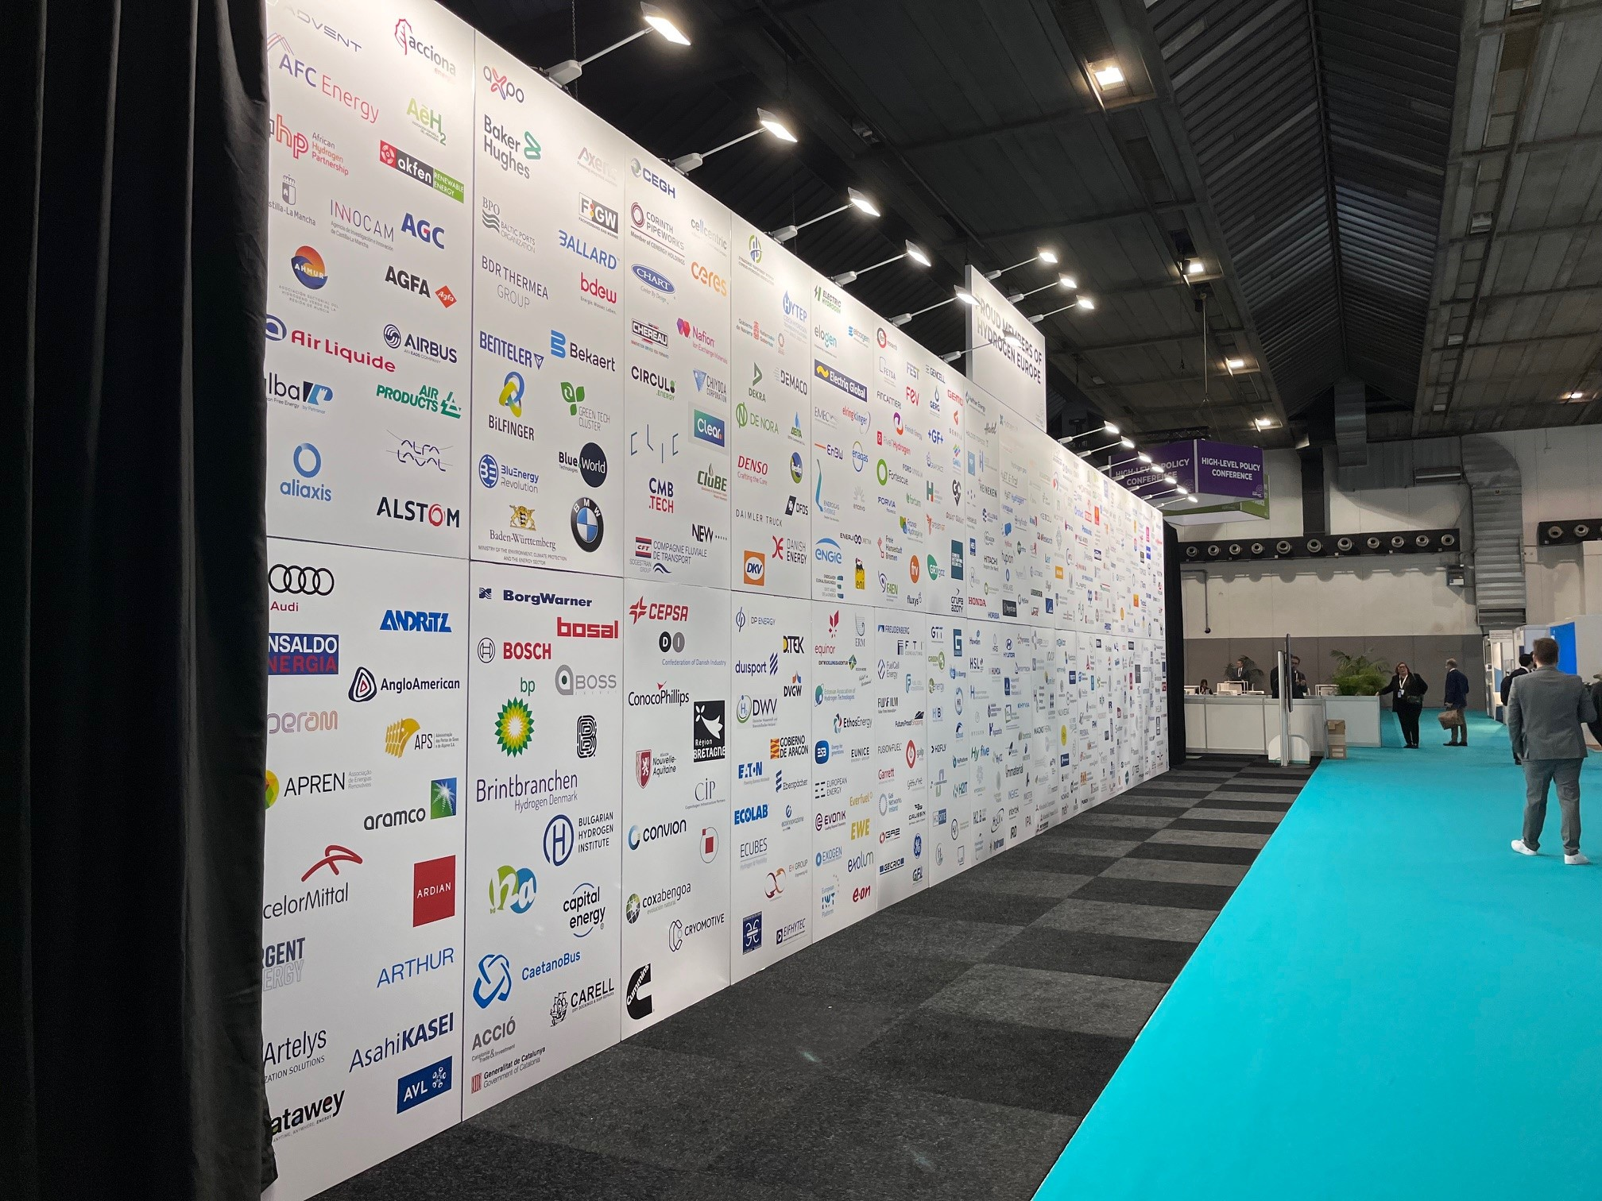
Hydrogen Europe
With a dedicated secretariat based in Brussels, Hydrogen Europe offers a variety of services and benefits to its members, working closely with the EU institutions and stakeholders to propel global carbon neutrality by accelerating the European hydrogen industry.
FUNDING
Accelerate the development of new technologies and expand your business
KNOWLEDGE
Access our dynamic encyclopaedia of constantly updated intelligence to help you make strategic decisions.
NETWORK
Benefit from access to multiple events a year where you can connect with our 450+ members, including leading businesses and associations with a stake in hydrogen.
COMMUNICATION
Keep updated with the latest hydrogen developments through our podcasts, webinars and publications.
ADVOCACY
Ensure your voice is heard when shaping European policy.

Slide 4
International, non–profit association
150 Universities and Research & Technology Organisations (RTO)
Members from 29 countries all over Europe and beyond.
The members of HER are active within the European hydrogen and fuel cells sector.
Hydrogen Europe Research organises once per month a Policy Working Group to discuss with members policy developments at the European level that could impact the research community. The purpose of this working group is to promote the voice of the scientific community on the European political stage
Together, Hydrogen Europe Research and Hydrogen Europe set up a Working Group to discuss skills needs in the hydrogen sector and how to address them. Different stakeholders are gathered in the working group: universities, research centers, industry players, regions and national associations.
Have first-hand access to essential information and calls for proposals in the Clean Hydrogen Partnership

Slide 5
Clean Hydrogen Partnership
Consists of the members:
Hydrogen Europe Research
European Commission
Hydrogen Europe of the Clean Hydrogen Joint Undertaking (JU),
Institutionalised European Partnership which aims to accelerate the development and deployment of a European value chain for clean hydrogen technologies.
The underlying aim of the Clean Hydrogen JU is to contribute to the achievement of the European Union’s objectives for a climate-neutral Europe by 2050.

Slide 6
European Hydrogen Week 2023
The event is a collaboration between Hydrogen Europe, the European Commission, and the Clean Hydrogen Partnership. The focus is to facilitate discussions, knowledge sharing, and exploration of new advancements in the hydrogen sector.
In-depth Sessions: Over 25 sessions featuring around 200 expected speakers, providing insights into industry trends and challenges.
Exhibition Area: Showcasing the latest in electrolyser, fuel cell technologies, and hands-on experiences with hydrogen-powered vehicles.
Networking Opportunities: Engage with stakeholders from various sectors, including policymakers, industry leaders, and researchers.
Trends & Innovations: Stay informed about emerging technologies and methodologies in the hydrogen realm.

Slide 7
The EU Hydrogen week venue

Slide 8
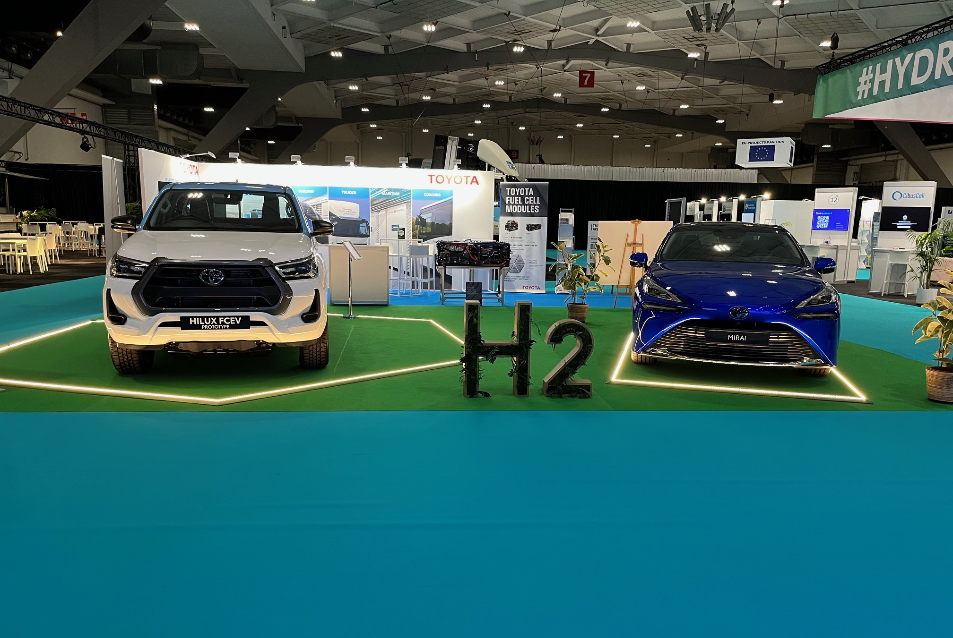
Toyotas och BMWs vätgasbilar

Slide 9
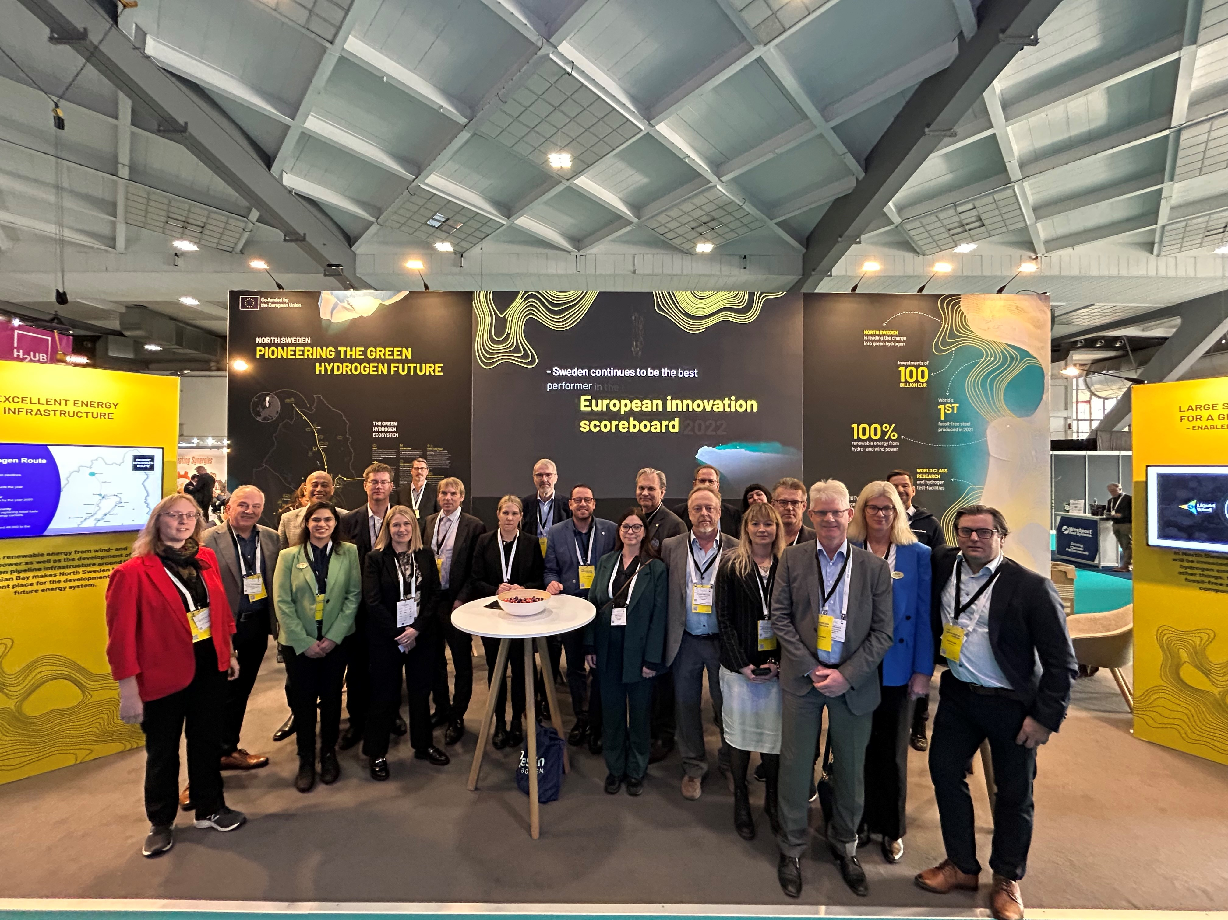
Norrbotten och Västerbotten representerade

Slide 10
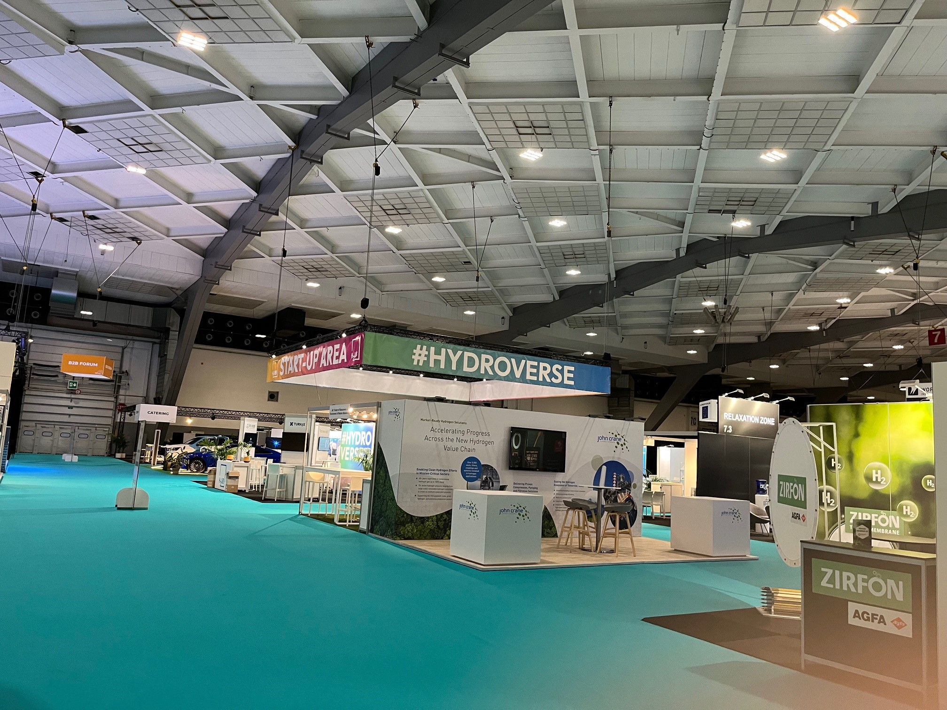
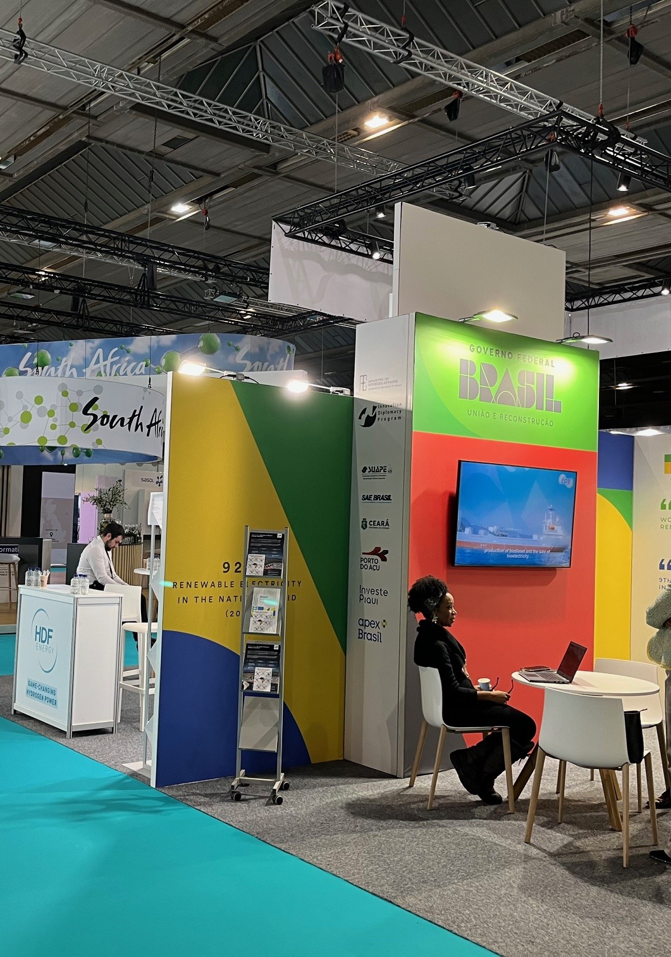
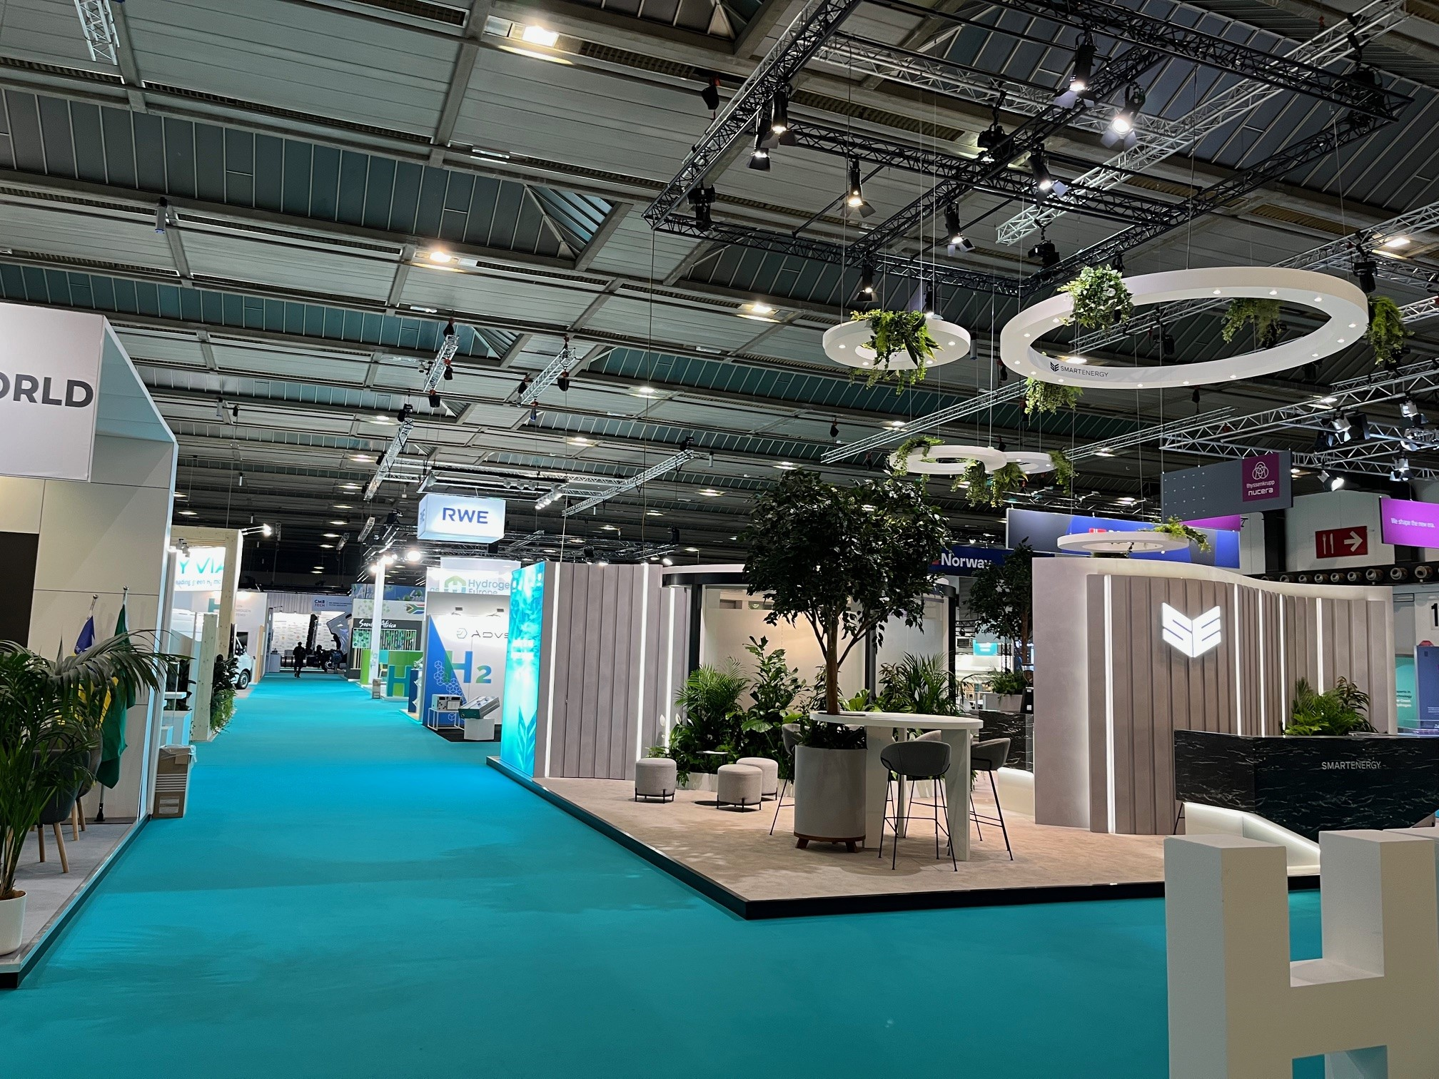
The Venue
Stora påkostade montrar
Stora företag
Länder
Stora regioner

Slide 11
Personliga möten med representanter från EU

Slide 12
Sammanfattning
Varför ska man besöka Hydrogen Week?
Konferensen har växt, kommer den fortsätta göra det?
Kommer det finnas fortsatt mycket pengar till forskning?

