Slide 1
Energiforsk Project: Lectures in the Power Plants
Fortum (Helsinki), TVO (Olkiluoto), Jan./Febr. 2024
Annual Energiforsk Seminar (10.11.21)
Vorlesungen Mechatronik im Wintersemester
Vibrations of Pumps in Nuclear Power Plants
Lecture III Vibrations of Cooling Pumps in Nuclear Power Plants
Rainer Nordmann
Technische Universität Darmstadt

Slide 2
Lecture III Vibrations of Cooling Pumps in Nuclear Power Plants
Vertical and Horizontal Pump Systems in Nuclear Power Plants
A typical Vertical Reactor Coolant Pump
Lateral Vibrations of the Vertical Reactor Coolant Pump
Modelling of the Vertical Reactor Coolant Pump with Interactions
Monitoring of the Vertical Reactor Coolant Pump during Operation
Vibration Phenomena for a Vertical Reactor Coolant Pump
Vibration Phenomena of a Condenser Cooling Water Pump

Slide 3
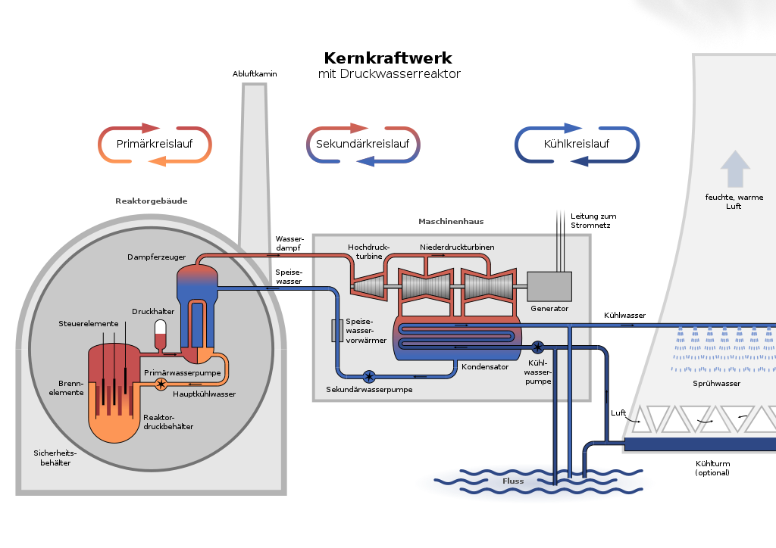
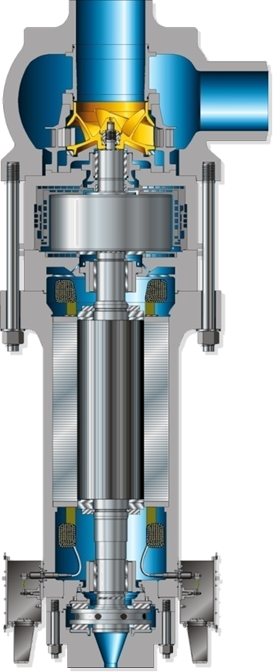
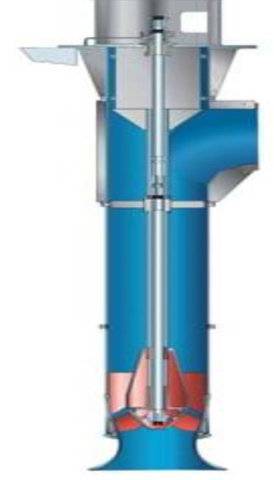
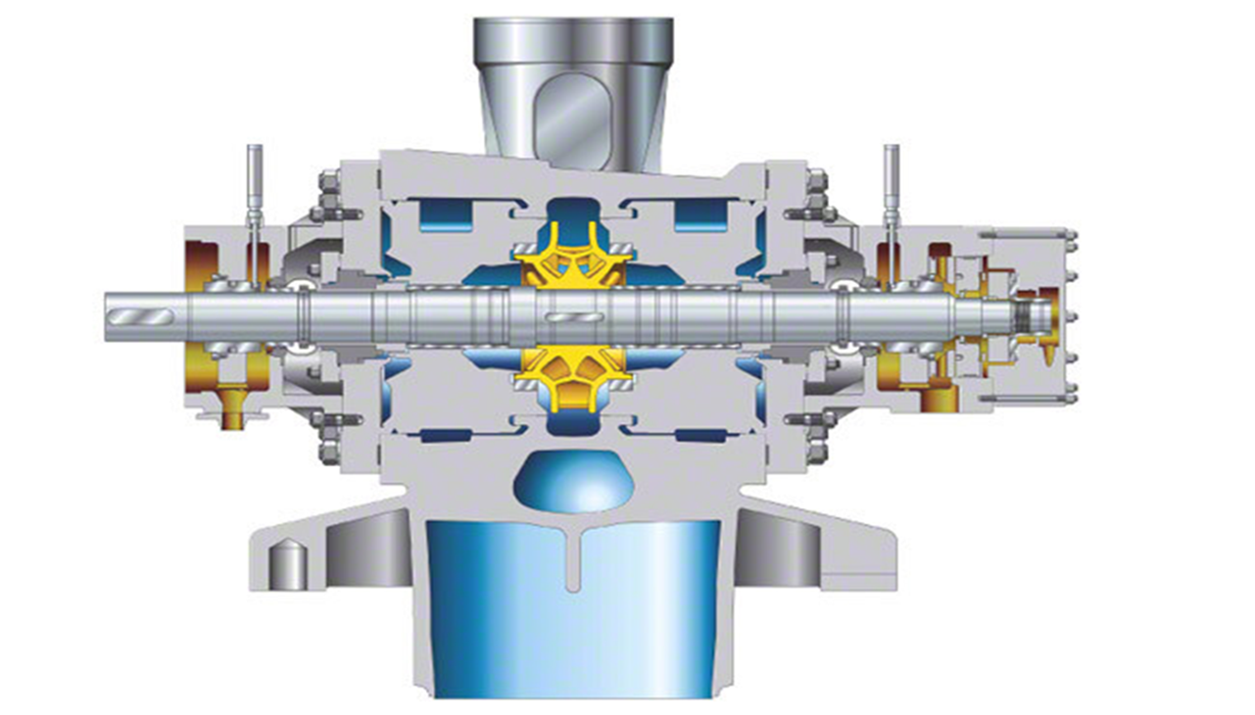
Vertical and Horizontal Pump Systems in Nuclear Power Plants
Reactor Coolant Pump, Feedwater Pump, Cooling Water Pump
Vertical Reactor
Coolant Pumps (PWR)
Nuclear Power Plant
Pressurized Water Reactor (PWR)
PWR PWR
(BWR)
Horizontal Vertical
Feedwater Pump Cooling Water Pump

Slide 4
Vertical and Horizontal Pump Systems in Nuclear Power Plants
Reactor Coolant Pumps
Vertical Reactor
Coolant Pumps (PWR)
Nuclear Power Plant
Pressurized Water Reactor (PWR)
PWR PWR
(BWR)
Horizontal Vertical
Feedwater Pump Cooling Water Pump

Slide 5
Lecture III Vibrations of Cooling Pumps in Nuclear Power Plants
Vertical and Horizontal Pump Systems in Nuclear Power Plants
A typical Vertical Reactor Coolant Pump
Lateral Vibrations of the Vertical Reactor Coolant Pump
Modelling of the Vertical Reactor Coolant Pump with Interactions
Monitoring of the Vertical Reactor Coolant Pump during Operation
Vibration Phenomena for a Vertical Reactor Coolant Pump
Vibration Phenomena of a Condenser Cooling Water Pump

Slide 6
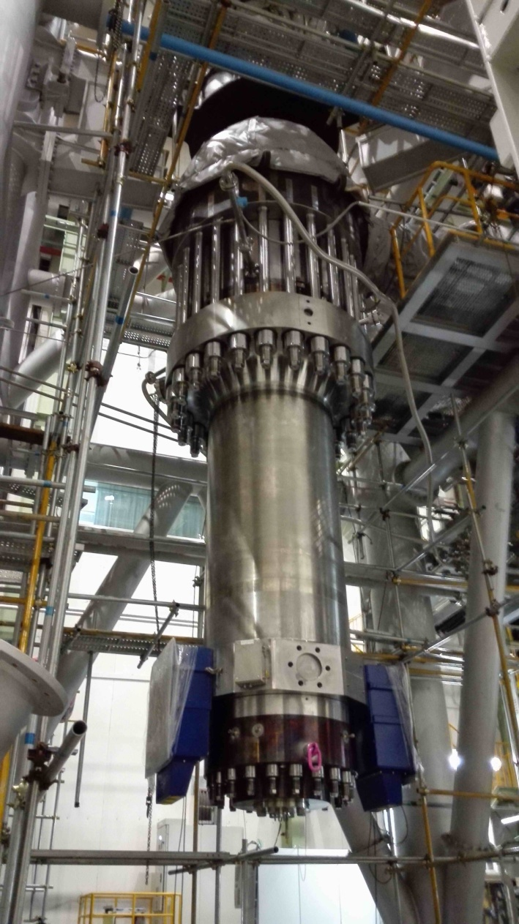
A typical Vertical Reactor Coolant Pump
Components of the Coolant Pump
Impeller
Flywheel
Electric Motor Drive
Three Radial Fluid Bearings
Axial Fluid Bearing
Pump Casing
(Source: KSB Handbook)

Slide 7
A typical Vertical Reactor Coolant Pump
Pump Characteristics
Power 8000 kW
Capacity 21650 m³/h
Pressure 175 bar
Temperature 280 °C
Rotational Speeds 1780 rpm
(Source: KSB Handbook)

Slide 8
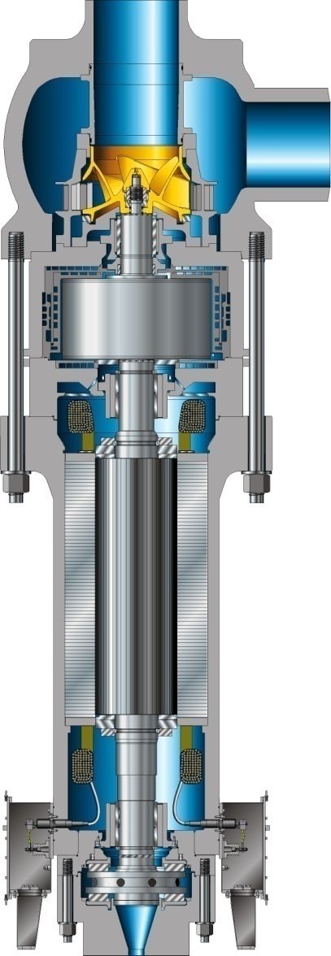
A typical Vertical Reactor Coolant Pump
Cross Section with Components of the Coolant Pump
Radial fluid film bearing (water)
Upper Motor
fluid film bearing (water)
Lower Motor
fluid film bearing (water)
Axial bearing
Pump casing
Impeller
Flywheel
Electric Motor,
rotor and stator
with long clearance
(Source: KSB Handbook)

Slide 9
A typical Vertical Reactor Coolant Pump
Important System Components regarding Vibrations
Pump Casing
Seals
Rotating Shaft
with Impeller, Flywheel, Motor
Motor Stator
3 Radial Fluid Film Bearings (water)
1 Axial Fluid Film Bearing

Slide 10
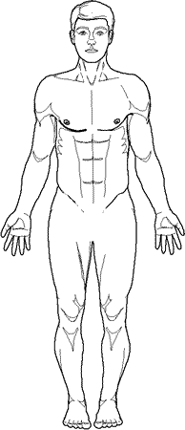
A typical Vertical Reactor Coolant Pump
Overview: Vibration Phenomena in Vertical Pumps
Vibrations of Vertical Pumps
Fluid Dynamics & Mechanics
Stresses
Material Strengths
Rotordynamics with
Interaction Effects
Unbalance Vibrations,
Critical Speeds,
Vibrations due to Hydr. Forces
Rotor Fluid Interactions and
Rotor Structure Interactions
Rotor Instability,
Whirl and Whip

Slide 11
Lecture III Vibrations of Cooling Pumps in Nuclear Power Plants
Vertical and Horizontal Pump Systems in Nuclear Power Plants
A typical Vertical Reactor Coolant Pump
Lateral Vibrations of the Vertical Reactor Coolant Pump
Modelling of the Vertical Reactor Coolant Pump with Interactions
Monitoring of the Vertical Reactor Coolant Pump during Operation
Vibration Phenomena for a Vertical Reactor Coolant Pump
Vibration Phenomena of a Condenser Cooling Water Pump

Slide 12

Lateral Vibrations of the Vertical Reactor Coolant Pump
Excitation and Reaction Forces for Lateral Vibrations
Impeller Fluid Forces
Unbalance Forces
Radial Fluid Bearing Forces
Electromagnetic
Forces
Excitation Forces Reaction Forces

Slide 13
Lateral Vibrations of the Vertical Reactor Coolant Pump
Motivation for an Analysis of Vibration Phenomena
How is the influence of time dependent forces (moments) on the dynamic behavior of a Pump System?
Which motions of vibration and which internal stresses
act on the rotating and on the non-rotating machine parts of the Pump?
Are critical conditions (Resonances, Critical Speeds, Instabilities) possible?
Can vibrations destroy machine parts?
Rubbing, shaft cracks, bearing failures, large deformations,…
Which Interactions have to be considered?
Fluid Structure Interactions FSI (Impeller, bearings, seals),
Rotor Structure Interaction RSI (Pump casing, foundation)
Electromechanical Interaction in the motor drive

Slide 14

Lateral Vibrations of The Vertical Reactor Coolant Pump
Characteristics of Lateral Vibrations
Lateral Vibrations: perpendicular to the
shaft axis with bending along the shaft line.
Physical Effects: Inertia (masses), stiffness
and damping of the system components,
including Bearings and Seals
Dynamic Characteristics: Lateral natural
frequencies, critical speeds, natural modes, damping,
stability, Frequency Response Functions (FRF)
Excitations:
Mech. & Hydraulic Unbalance forces, (rotational frequency),
Fluid forces at the impeller with vane passing frequency
Electromagnetic forces at the motor
Self excited vibrations, Instability in bearings and seals

Slide 15
Lecture III Vibrations of Cooling Pumps in Nuclear Power Plants
Vertical and Horizontal Pump Systems in Nuclear Power Plants
A typical Vertical Reactor Coolant Pump
Lateral Vibrations of the Vertical Reactor Coolant Pump
Modelling of the Vertical Reactor Coolant Pump with Interactions
Monitoring of the Vertical Reactor Coolant Pump during Operation
Vibration Phenomena for a Vertical Reactor Coolant Pump
Vibration Phenomena of a Condenser Cooling Water Pump

Slide 16
Modelling of the Vertical Reactor Coolant Pump with Interactions
Input Output Relations
Vibrations of
Pump System
=
Dynamics of
Pump System
x
Excitation of
Pump Sytem
Output
Pump System
Input
Matrices M, D, G, K or
Natural frequencies
Damping
Mode shapes
Lateral Vibrations
Mech. & Hydraulic Unbalance (Exc. Ω)
Fluid forces (Exc. nΩ)
E-Magnetic forces
Self - Excitation

Slide 17
Modelling of the Vertical Reactor Coolant Pump with Interactions
Input Output Relations
Excitations F(t)
Unbalance Forces
Fluid Forces
Electromagnetic Forces
Vibration Response x(t)
Unbalance Response
Fluid Forces Response
Response to Emagnetic Forces
Dynamic Characteristics of the Pump System:
Physical Parameters: Mass, Damping & Stiffness of Shaft, Fluid Bearings, Seals
Modal Parameters: Natural frequencies, Damping, Natural modes,

Slide 18
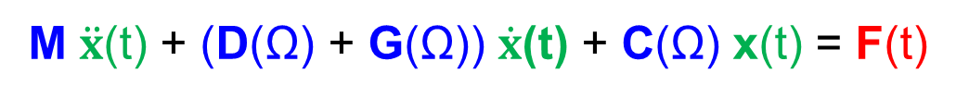
Modelling of the Vertical Reactor Coolant Pump with Interactions
Input Output Relations, Equations of Motion
Excitations F(t)
Unbalance Forces
Fluid Forces
Electromagnetic Forces
Vibration Response x(t)
Unbalance Response
Fluid Forces Response
Emagnetic Forces Respose
K(
K
The Equations of Motion of the Pump contain the stiffness & damping & mass information of the shaft and the bearings and seals. The dynamic influences of the casing and the piping can be added.

Slide 19
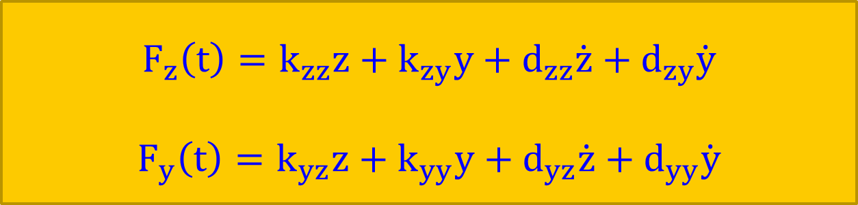
Modelling of the Vertical Reactor Coolant Pump with Interactions
Stiffness and Damping Coefficients of Fluid Film Bearings and Seals
The Forces of Fluid Film Bearings and Seals can be presented by stiffness and damping coefficients k_{ij} and d_{ij} in linear form:
They depend on the geometry (diameter, width, clearance) of the Bearings and Seals, on the physical fluid data (density, viscosity, temperature) and on the operating conditions (rotational speed, pressure, temperature, ..).
.
$$F_{z}\left(t\right)=k_{zz}z+k_{zy}y+d_{zz}\dot{z}+d_{zy}\dot{y}$$
$$F_{y}\left(t\right)=k_{yz}z+k_{yy}y+d_{yz}\dot{z}+d_{yy}\dot{y}$$

Slide 20
Modelling of the Vertical Reactor Coolant Pump with Interactions
Stiffness and Damping Coefficients of Fluid Film Bearings and Seals
The stiffness and damping coefficients of Fluid film Bearings and Seals can be determined by Numerical calculations (CFD) or by Experiments.
Example: For a bearing with a special geometry the coefficients depend on the Sommerfeld number So. Fluid film bearings have anisotropic behavior :
kzz ≠ kyy and dzz ≠ dyy
The coupling coefficients differ from each other (unsymmetry):
kzy ≠ kyz and dzy ≠ dyz
A measure for instability sensitivity is the difference: (kzy – kyz).

Slide 21
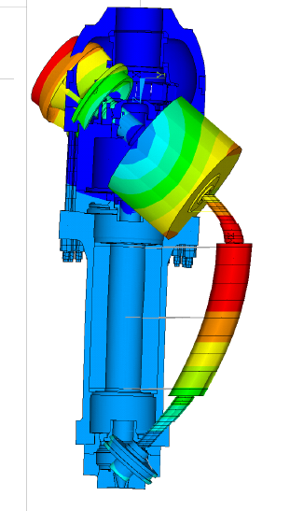
Modelling of the Vertical Reactor Coolant Pump with Interactions
Natural Vibrations: Eigenvalues and Mode Shapes
Natural frequency ꞷ
Damping α
Bending mode
( λ² M + λ(D(Ω) + G(Ω)) + K (Ω))∙ x = 0
Complex Eigenvalues : λ = α + j ω
Information for natural frequencies ω and damping α (stability)

Slide 22

Modelling of the Vertical Reactor Coolant Pump with Interactions
Lateral Vibrations due to Mechanical and Hydraulic Unbalance Forces
Mech. Unbalance forces act mainly at the
main masses m: impeller, flywheel
and motor. For each mass they are
defined by amplitude meΩ² and phase
Hydr. Unbalance forces are Fluid Forces
acting at the impeller
(( K(Ω) - Ω² M) + jΩ ( D (Ω) + G (Ω)) x = U Ω² F_{i}
Complex System response x_{i} contains amplitude and phase

Slide 23
Modelling of the Vertical Reactor Coolant Pump with Interactions
Equations of Motion – Rotor Structure Interaction RSI
The Pump casing and the pipes interact with the pump shaft at several locations (x): Fluid Bearings, Impeller, etc.
The dynamic behavior of the Pump casing and the pipes can be expressed by Frequency Response Functions FRFs, e.g. by H_{nm} (see next figure).
FRFs can be presented by means of natural frequencies, mode shapes and modal damping values and the frequency of excitation Ω.
They can be measured or calculated by means of the Finite Element Method.
x
x
x
x

Slide 24
Modelling of the Vertical Reactor Coolant Pump with Interactions
Equations of Motion – Rotor Structure Interaction RSI
Pump Casing
without Rotor
Upper Motor
Fluid Film Bearing
Force Input F_{m}
Lower Motor
Fluid Film Bearing
Vibrat. Output x_{n}
Frequency Response
Function FRF: H _{nm}
F_{m}(t) Harmonic Force at location m
at the upper Motor Bearing
x
x
x_{n}(t) Harmonic Response at location n
at the lower Motor Bearing

Slide 25
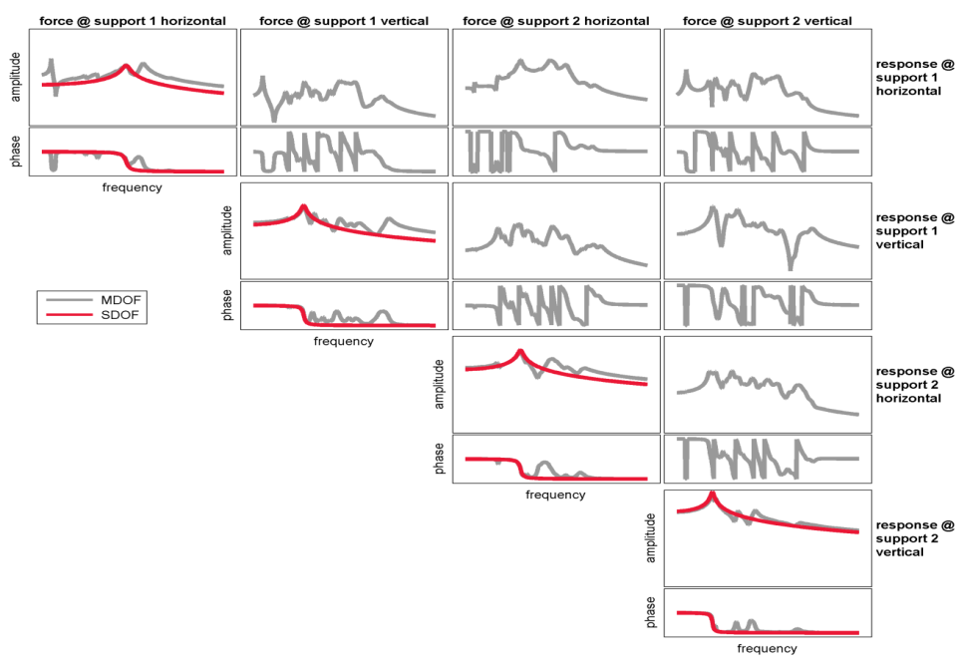
Modelling of the Vertical Reactor Coolant Pump with Interactions
Equations of Motion – Rotor Structure Interaction RSI
Coupling of the above Rotordynamic Equations and the FRFs of the Pump
casing leads to the Equations of Motion for the complete Pump System with
Rotor Structure Interaction RSI.
X
Example: 16 FRFs between
the upper and the lower
motor bearing for the
Pump Casing in
two directions (4 DOF)
X

Slide 26
Lecture III Vibrations of Cooling Pumps in Nuclear Power Plants
Vertical and Horizontal Pump Systems in Nuclear Power Plants
A typical Vertical Reactor Coolant Pump
Lateral Vibrations of the Vertical Reactor Coolant Pump
Modelling of the Vertical Reactor Coolant Pump with Interactions
Monitoring of the Vertical Reactor Coolant Pump during Operation
Vibration Phenomena for a Vertical Reactor Coolant Pump
Vibration Phenomena of a Condenser Cooling Water Pump

Slide 27

Monitoring of the Vertical Reactor Coolant Pump during Operation
Example: Monitoring by means of Relative Displacement Sensors
Relative Displacement
Sensors in two directions
For Monitoring of Pump Systems absolute vibration velocities in mm/sec and/or relative shaft vibrations in µm at defined locations (Bearings) are usually measured. Vibrations are evaluated by ISO Standards or other Standards.

Slide 28
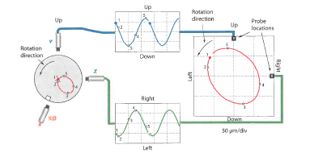
Monitoring of the Vertical Reactor Coolant Pump during Operation
Orbits of Relative Shaft Motions
Measurement of relative shaft vibrations in horizontal and vertical direction by means of displacement sensors. By superpositon of the two signals in one plane Orbits can be determined. They show the Shaft motions in the measurement plane.

Slide 29
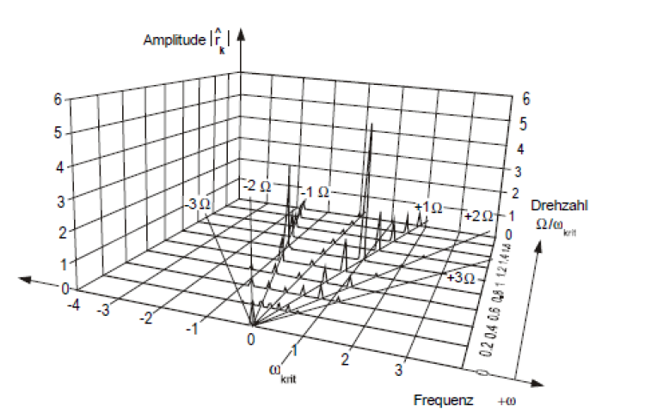
Monitoring of the Vertical Reactor Coolant Pump during Operation
Frequency Analysis with Forward and Backward Frequencies
Backward (-) Forward (+)
Frequency Analysis with both, forward- and backward frequencies, are very helpful to analyze Vibrations and to diagnose typical failures e.g. unbalance with elliptical orbits, shaft cracks, shafts with unequal moments of inertia,etc…

Slide 30
Lecture III Vibrations of Cooling Pumps in Nuclear Power Plants
Vertical and Horizontal Pump Systems in Nuclear Power Plants
A typical Vertical Reactor Coolant Pump
Lateral Vibrations of the Vertical Reactor Coolant Pump
Modelling of the Vertical Reactor Coolant Pump with Interactions
Monitoring of the Vertical Reactor Coolant Pump during Operation
Vibration Phenomena for a Vertical Reactor Coolant Pump
Vibration Phenomena of a Condenser Cooling Water Pump

Slide 31
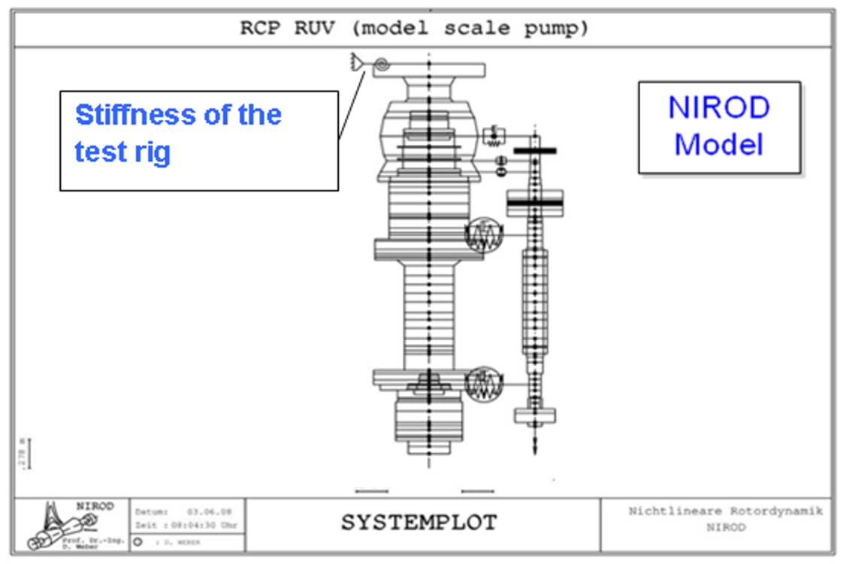
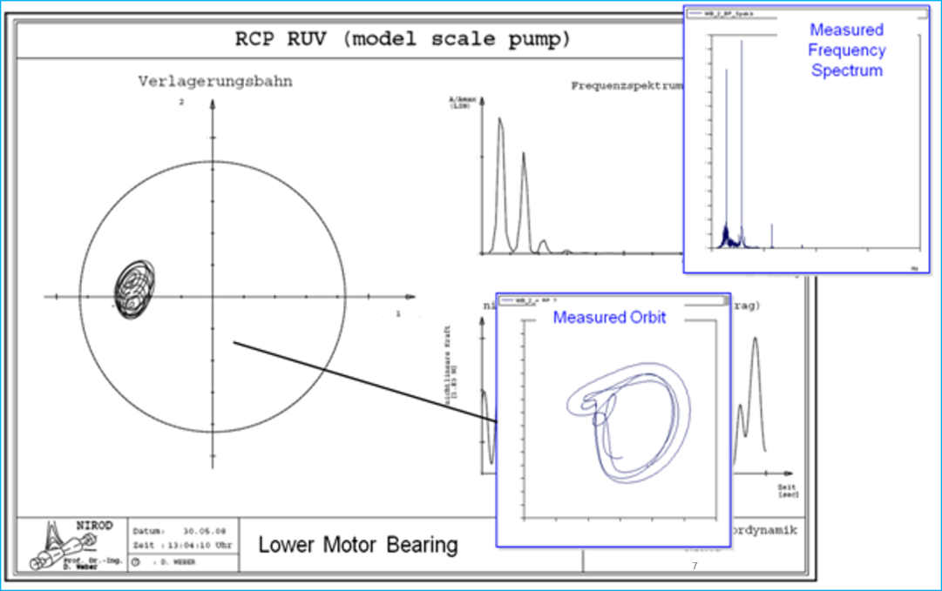
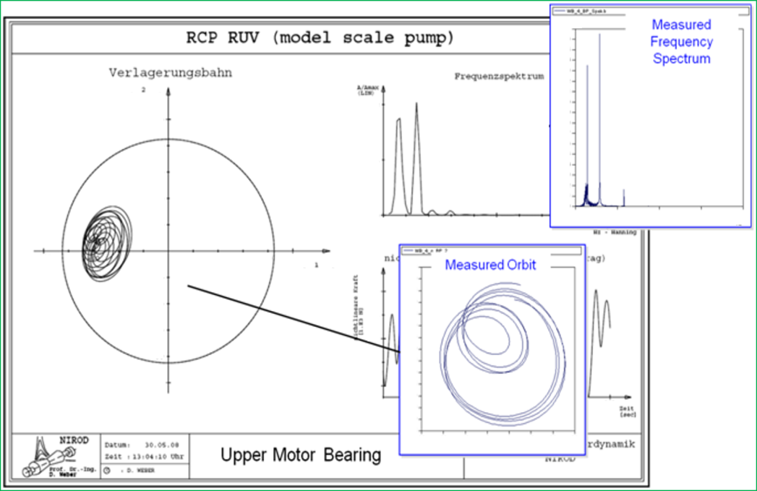
Vibration Phenomena for a Vertical
Reactor Coolant Pump
Unbalance Vibrations with shaft rotational frequency Ω and unstable vibrations with ~ Ω/2 (whirl).
Calculated and measured Orbits and Frequency Spectra at the lower and upper motor bearing.
Pump
Modelling of a RCP Test Pump System
Orbits and Spectra
Orbits and Spectra

Slide 32
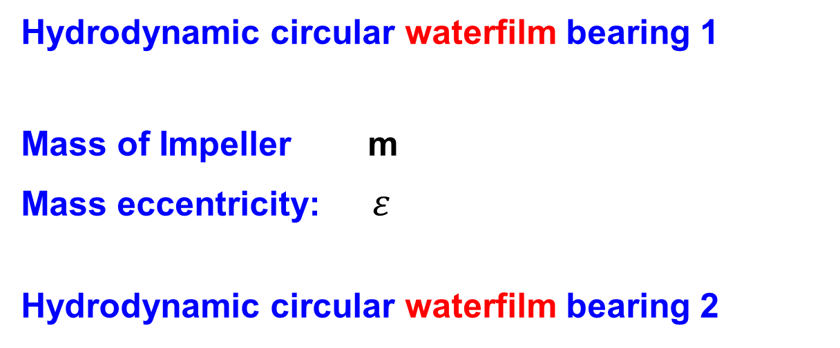
Vibration Phenomena for a Vertical Reactor Coolant Pump
Simple Example: Lateral Vibrations due to Unbalance Forces and Instability
This study investigates the lateral vibrations of a rigid mass m with unbalance, running with angular velocity Ω in cylindrical hydrodynamic waterfilm bearings. The shaft arrangement is vertical
Hydrodynamic circular waterfilm bearing 1
Mass of Impeller m
Mass eccentricity: $ε$
Hydrodynamic circular waterfilm bearing 2

Slide 33
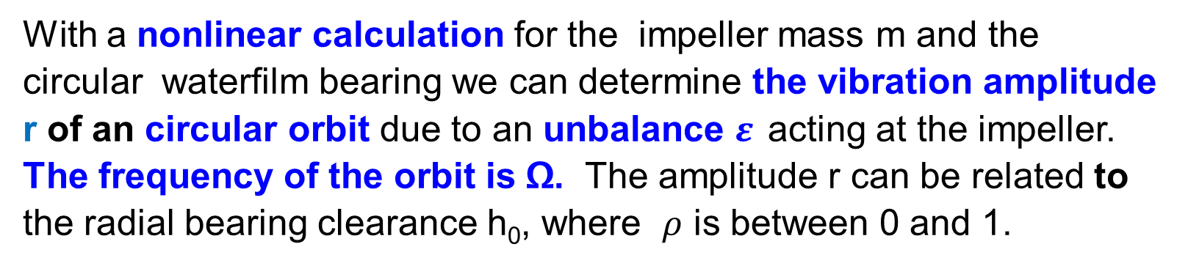
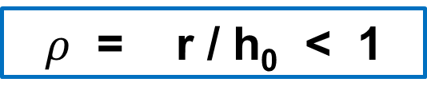
Vibration Phenomena for a Vertical Reactor Coolant Pump
Simple Example: Lateral Vibrations due to Unbalance Forces and Instability
With a nonlinear calculation for the impeller mass m and the circular waterfilm bearing we can determine the vibration amplitude r of an circular orbit due to an unbalance $ε$ acting at the impeller. The frequency of the orbit is Ω. The amplitude r can be related to the radial bearing clearance h₀, where $ρ$ is between 0 and 1.
$ρ$ = r / h₀ < 1

Slide 34
Vibration Phenomena for a Vertical Reactor Coolant Pump
Simple Example: Lateral Vibrations due to Unbalance Forces and Instability
This diagram shows, that stable and unstable motions are possible.
Are we in a stable or unstable range?
Stable Range: Circular Orbit
Unstable Range: Subsynchronous vibrations will appear.
Finally a solution has to be found numerically.

Slide 35
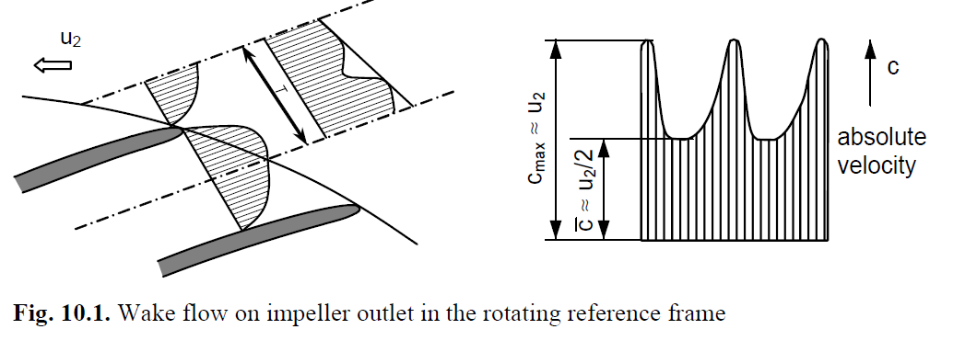
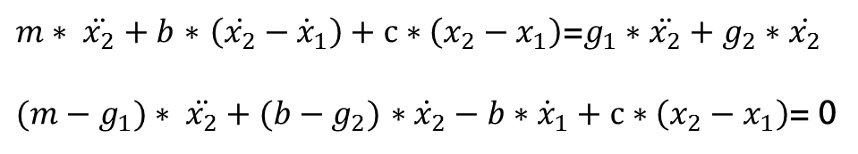
Vibration Phenomena for a Vertical Reactor Coolant Pump
Hydraulic Forces due to Fluid Structure Interaction FSI.
The Fluid Structure Interaction FSI creates Hydraulic forces with the blade passing frequency f = f_{rot} x n and higher Harmonics of it. f_{rot} = Ω/ 2π is the rotational frequency of the pump shaft and n is the number of blades.

Slide 36
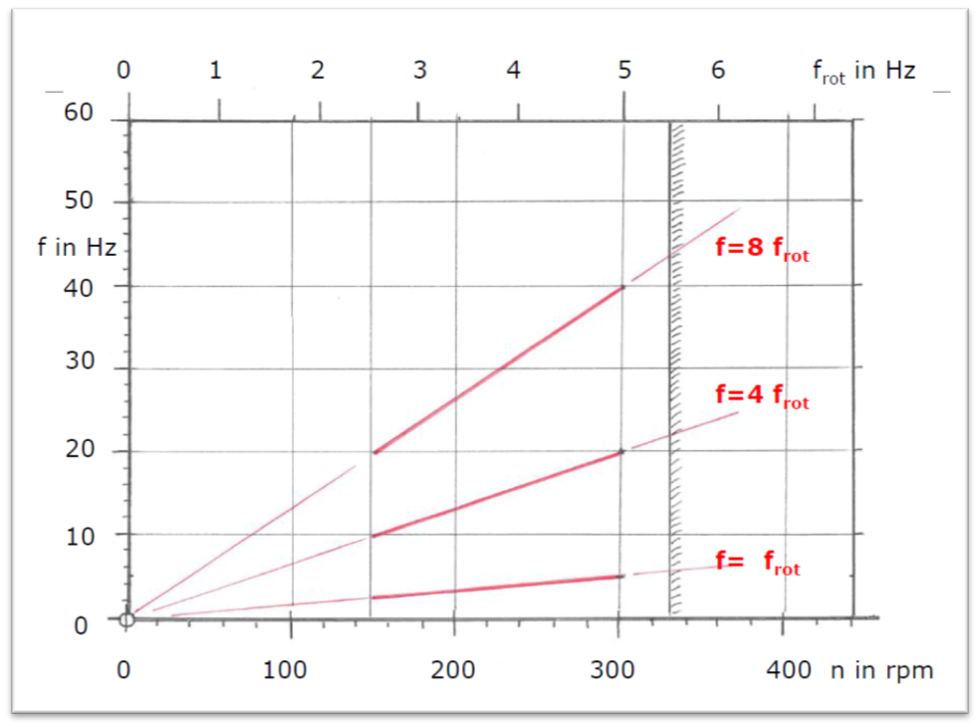
Vibration Phenomena for a Vertical Reactor Coolant Pump
Example: Hydraulic Forces for an Impeller with n = 4 blades
Campbell diagram
Excitation
lines
2x vane passing
frequency
1x vane passing
frequency (n=4)
Unbalance
frequency
Resonance
f₂
Frequency f in Hz
Natural
frequencies
of a pump
Resonance
f₁
Rotational frequency of the Pump f_{rot} = Ω/ 2π

Slide 37
Vibration Phenomena for a Vertical Reactor Coolant Pump
Passive and Active Vibration Control for Vertical Pumps
 | Without Energy Conversion |  | With Energy Conversion
 | Passive |  |  | Semi-ctive | Active
Reduction of Excitation | Passive Balancing |  |  |  | Active Balancing
System Tuning | Tuning
Damping |  | Passive Damping |  |  | Active Damping
Vibration Absorber
Isolation of disturbance
Isolation to protect the receiver
Conventional Solution
Extended Solutions
Increase of:
Effectiveness, Complexity,
more Solution Variants
Notes:
Adaptive, semi-aktive und aktive Systeme zur Schwingungsminderung werden eingesetzt, wenn durch passive Maßnahmen gewünschte Produkteigenschaften oder gesetzliche Vorschriften nicht erreicht werden können.
Der Einsatz von aktiven Systemen führt zu Anstieg
der Lösungsvarianten / des Lösungsraums
der Komplexität des Systems
Erfordert methodische Herangehensweise an den Entwicklungsprozess
Etablierte Werkzeuge sind:
Numerische und experimentelle Verfahren der Strukturanalyse
numerische Systemsimulation

Slide 38
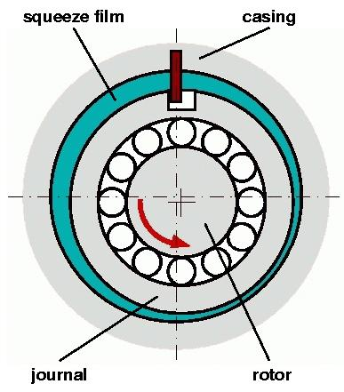
Vibration Phenomena for a Vertical Reactor Coolant Pump
Passive Vibration Control with Fluid Film Damping
Passive Vibration Control of the Vertical Pump by means of the Damping in the Fluid Film Bearings.
But Damping effect may be reduced due to the cross coupled stiffness terms. Needs Optimization!
Passive Squeeze Film Dampers improve the System Damping. Example for Roller Bearing

Slide 39
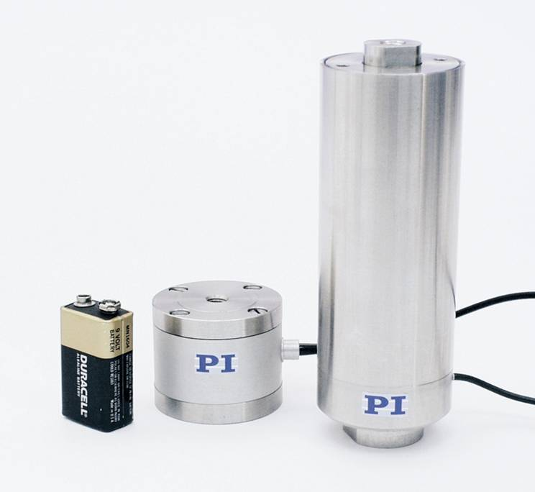
Vibration Phenomena for a Vertical Reactor Coolant Pump
Active Vibration Control with Piezo Actuators for Vertical Pumps
Active damping by means of Piezo Actuators at Bearing locations
Optimization of the entire operation range possible
Diagnosis / Failure Identification based on Frequncy Response Functions
Expensive Solution

Slide 40
Lecture III Vibrations of Cooling Pumps in Nuclear Power Plants
Vertical and Horizontal Pump Systems in Nuclear Power Plants
A typical Vertical Reactor Coolant Pump
Lateral Vibrations of the Vertical Reactor Coolant Pump
Modelling of the Vertical Reactor Coolant Pump with Interactions
Monitoring of the Vertical Reactor Coolant Pump during Operation
Vibration Phenomena for a Vertical Reactor Coolant Pump
Vibration Phenomena of a Condenser Cooling Water Pump

Slide 41
Vibration Phenomena of a Condenser Cooling Water Pump
Vertical Cooling Water Pump
Vertical Reactor
Coolant Pumps (PWR)
Nuclear Power Plant
Pressurized Water Reactor (PWR)
PWR PWR
(BWR)
Horizontal Vertical
Feedwater Pump Cooling Water Pump

Slide 42
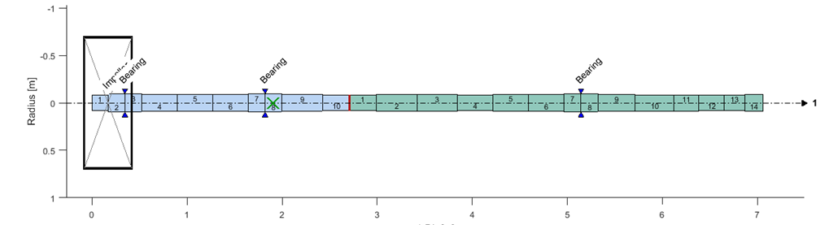
Vibration Phenomena of a Condenser Cooling Water Pump
Vertical Cooling Water Pump in a Power Plant
Real System of FE-Model of
Vertical Pump Vertical Pump
Capacity 23850 m³/h
Head 22 m
Rotational
Speed 480 rpm

Slide 43
Vibration Phenomena of a Condenser Cooling Water Pump
Vertical Cooling Water Pump
The measured vibrations at the cooling water pump show, that particularly synchronous harmonic vibrations with angular velocity Ω - rotational frequency of the pump shaft - are present in the frequency spectra.
Damages at the Pump shaft and at the Bearings furthermore verify, that harmonic forward vibrations on a circular orbit with the frequency Ω are the main course.
Based on these facts „Unbalance“ seems to be the dominant dynamic loading of the Cooling water pump

Slide 44
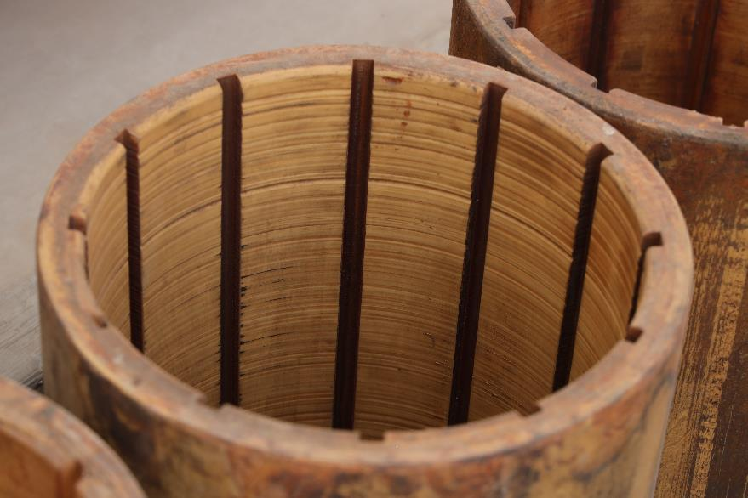
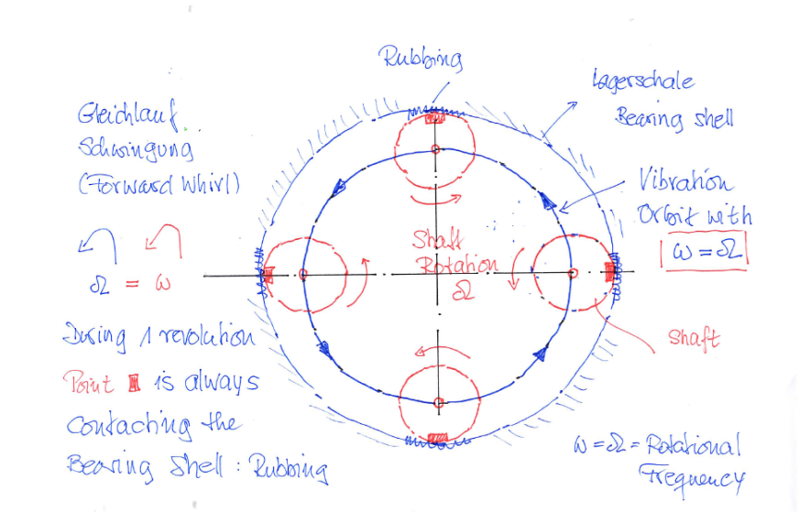
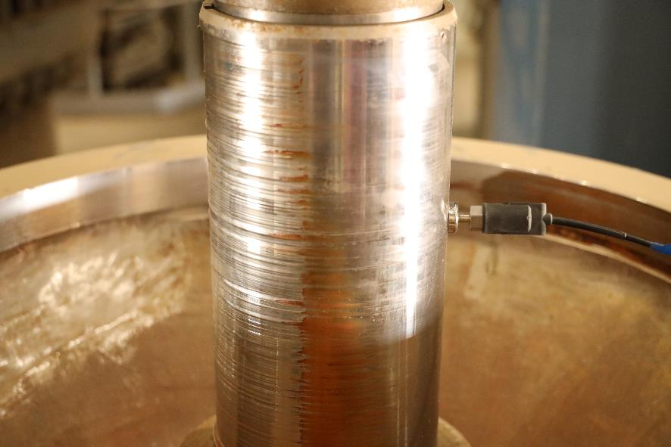
Vibration Phenomena of a Condenser Cooling Water Pump
Damages at the Pump Shaft and the Bearings

Slide 45
Vibration Phenomena of a Condenser Cooling Water Pump
Sources of Unbalance Excitation
There are mainly three possible sources of Unbalance Excitation:
Mechanical Unbalance
Unbalance due to shaft bow, e.g. by coupling errors
Hydraulic Unbalance

Slide 46
Vibration Phenomena of a Condenser Cooling Water Pump
Hydraulic Unbalance during Operation
There is a portion of the unsteady hydraulic impeller force which is
synchronous to the rotating frequency. This hydraulic force behaves exactly the same way as a mechanical unbalance.
Hydraulic Unbalance forces are caused by slight deviations from rotational symmetry of the fluid flow through the impeller channels (different blades and vanes, geometrical unequality, material roughess).
Hydraulic Unbalance can also be amplified by Unequal Energy transfer due to different Cavitation behavior in different blades

Slide 47
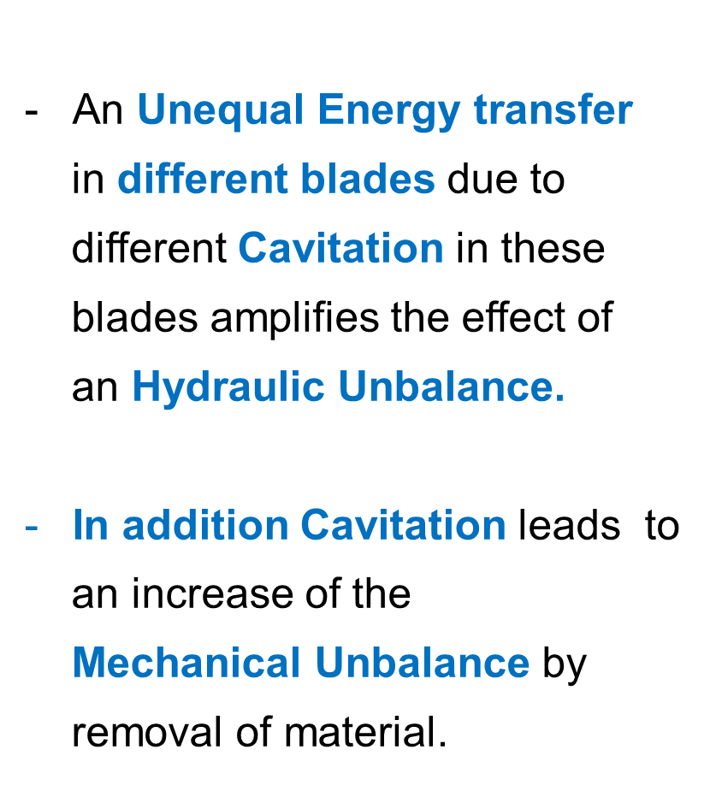
Vibration Phenomena of a Condenser Cooling Water Pump
Cavitation in a Vertical Cooling Water Pump

Slide 48
Vibration Phenomena of a Condenser Cooling Water Pump
Hydraulic Unbalance in a Vertical Cooling Water Pump
As mentioned before Hydraulic Unbalance forces originate in slight deviations from rotational symmetry of the flow through the impeller channels.
This is due to geometrical tolerances, i.e. varying vane exit angles and overall areas between vanes, and some eccentricity of the hydraulic passages relative to the bore of the impeller.
The deviations may be small, and not readily detectable during inspection after manufacturing.

Slide 49
Vibration Phenomena of a Condenser Cooling Water Pump
Manufacturing methods for Pump Impellers
The only way hydraulic unbalance loads can be reduced is by a more precise manufacturing procedure for the impellers.
For a specified manufacturing method, there is a fixed amount of unbalance that the system will be forced to tolerate regardless of how well the machine is balanced.
Manufacturing methods for pump impellers are:
Sand Cast,
Precision Sand Cast,
Machining

Slide 50
Vibration Phenomena of a Condenser Cooling Water Pump
Mechanical and Hydraulic Unbalance
Measurements of synchronous forces on the pump rotor do not allow the distinction between hydraulic and mechanical unbalance.
Hydraulic unbalance loads cannot be reduced by balancing.

Slide 51
Vibration Phenomena of a Condenser Cooling Water Pump
Normalized Force Coefficient for Hydraulic Unbalance
It is customary to represent hydraulic excitation forces in terms of a normalized force coefficient, defined as follows:

Slide 52
Vibration Phenomena of a Condenser Cooling Water Pump
Normalized Force Coefficients for Hydraulich Forces (Literature)
Hydraulic Unbalance Vane Pass Frequency

Slide 53
Vibration Phenomena of a Condenser Cooling Water Pump
Vertical Cooling Water Pump – Hydraulic Unbalance
Verhoeven (1988) states that the unbalance forces observed in practical pumps almost always exceed those that can be attributed to mechanical unbalance. The cause of this discrepancy is hydraulic unbalance forces, which he states are usually much larger than those due to mechanical unbalance.
Bolleter, et.al. (1989) second this statement in their paper

Slide 54
Vibration Phenomena of a Condenser Cooling Water Pump
Vertical Cooling Water Pump – Hydraulic Unbalance
Florjancic and Frei (1993) note that if the (mechanical unbalance corresponding to an ISO grade impeller having the value of 6,3 were converted into an equivalent K_{H} factor, it would be substancially lower than the hydraulic unbalance values quoted below for Precision Sand Cast impellers.
It is easily seen, that in most practical pumps, hydraulic unbalance plays a larger role in the rotordynamic characteristics than does mechanical unbalance.

Slide 55
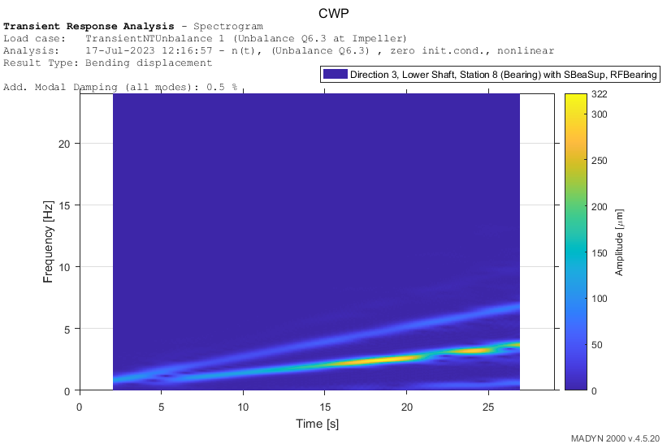
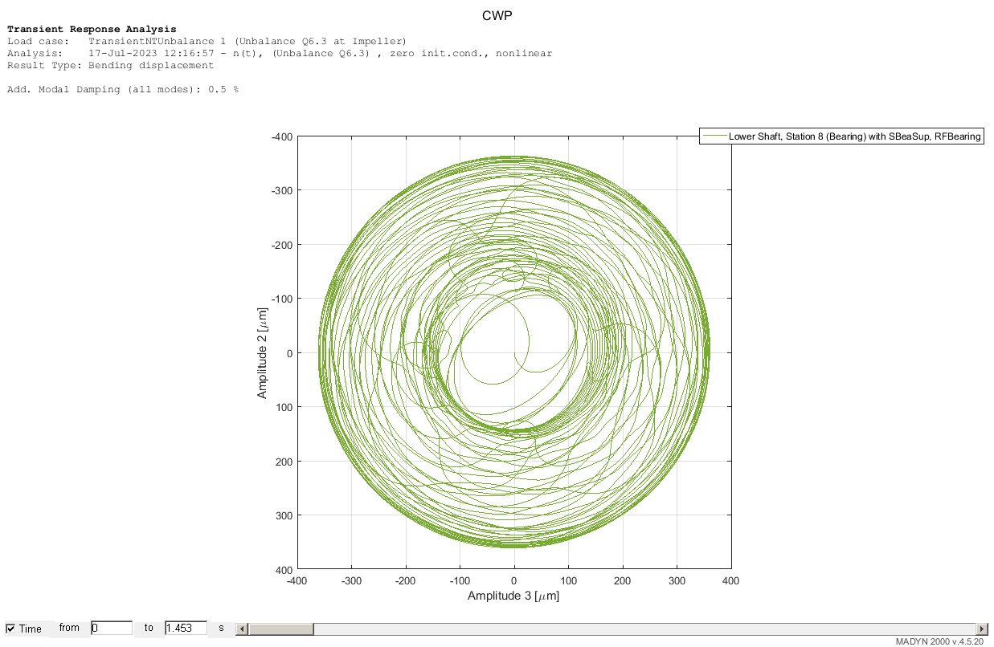
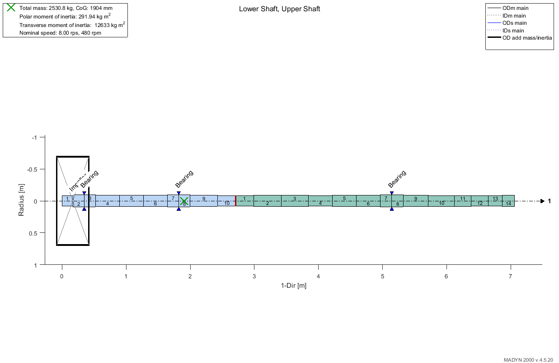
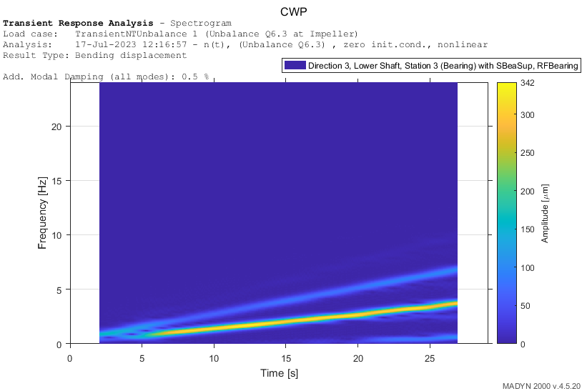
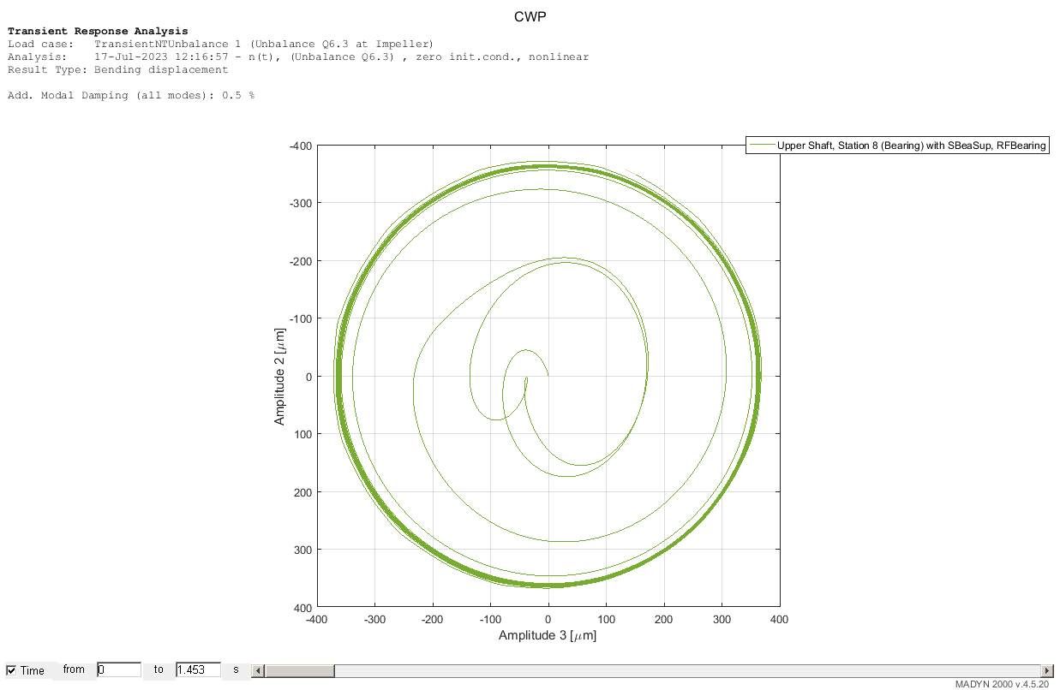
Vibration Phenomena of a Condenser Cooling Water Pump Nonlinear fluid bearings, Low Unbalance,with dominant Half Frequency (Instability)
Half Frequency
Whirl Ω/2

Slide 56
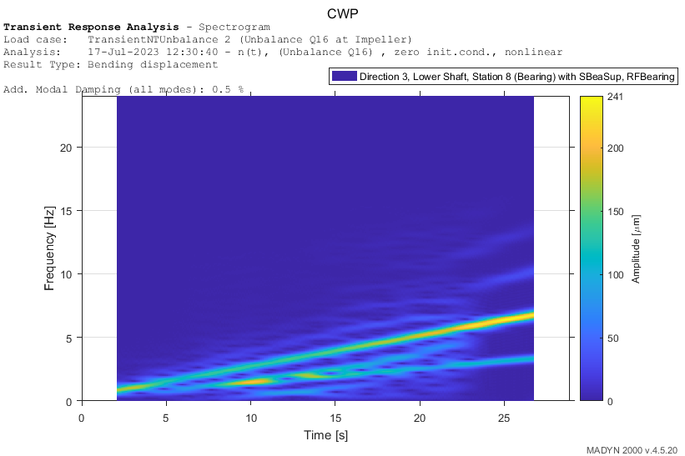
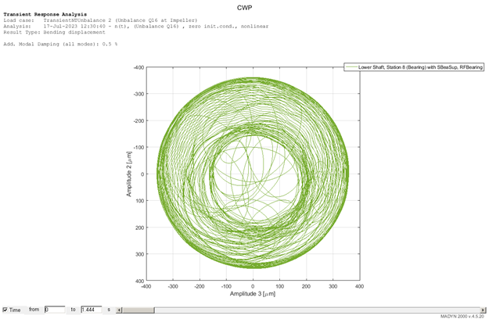
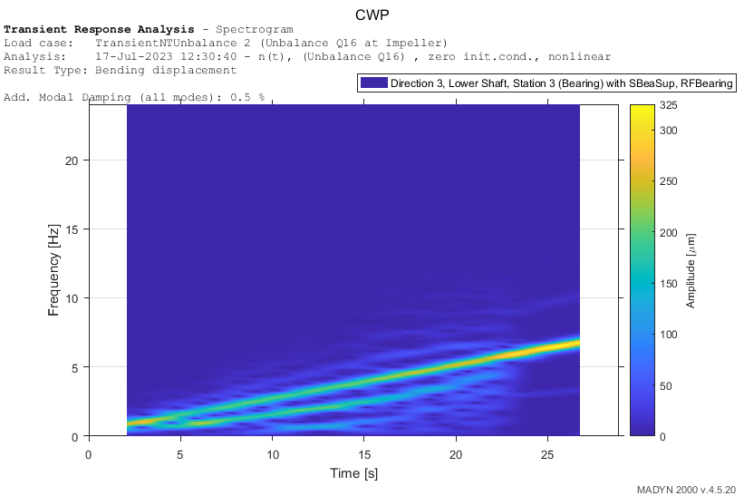
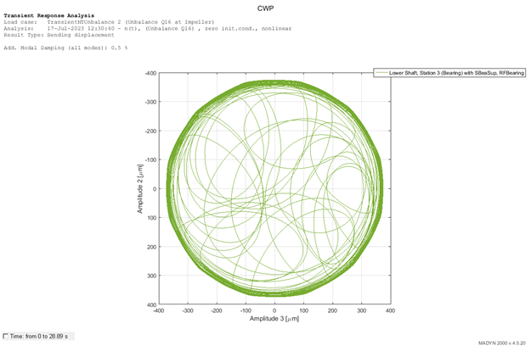
Nonlinear calculations for unbalance vibrations
Nonlinear fluid bearings , High Unbalance with dominant rotational frequency
Rotational
Frequency Ωl
Bending displacement in µm

Slide 57
Energiforsk Project: Lectures in the Power Plants
Fortum (Helsinki), TVO (Olkiluoto), Jan./Febr. 2024
Annual Energiforsk Seminar (10.11.21)
Vorlesungen Mechatronik im Wintersemester
Vibrations of Pumps in Nuclear Power Plants
Lecture III Vibrations of Cooling Pumps in Nuclear Power Plants
Rainer Nordmann
Technische Universität Darmstadt

